Slide 1
Web Scraping: Filterable Beers from BeerAdvocate
Bryan Cover

Slide 2
Why Study BeerAdvocate?
BeerAdvocate is an extensive online platform for beer styles, reviews, and scores. It features an active online community and offers a variety of data. I chose to take a look at this data for web scraping.
The beer data was scraped for each style, analysis was done on the data, and a filterable tool was made to allow users to filter results based on a variety of factors to find your next drink easily.
Almost 300,000 beers were scrapped in total. The data needed to be carefully scraped to react to user input and validate the results.

Slide 3
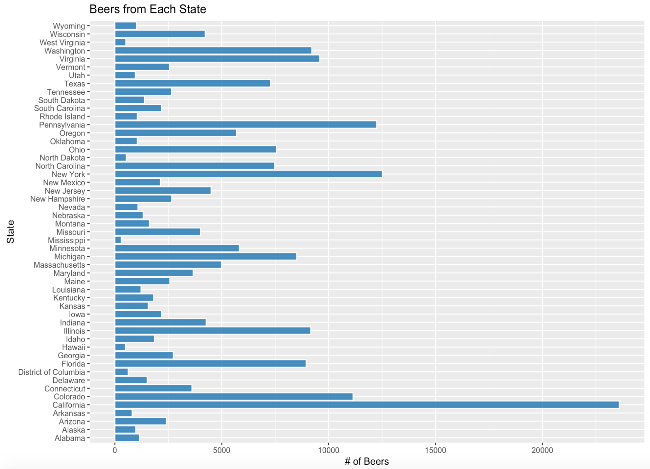

Slide 4
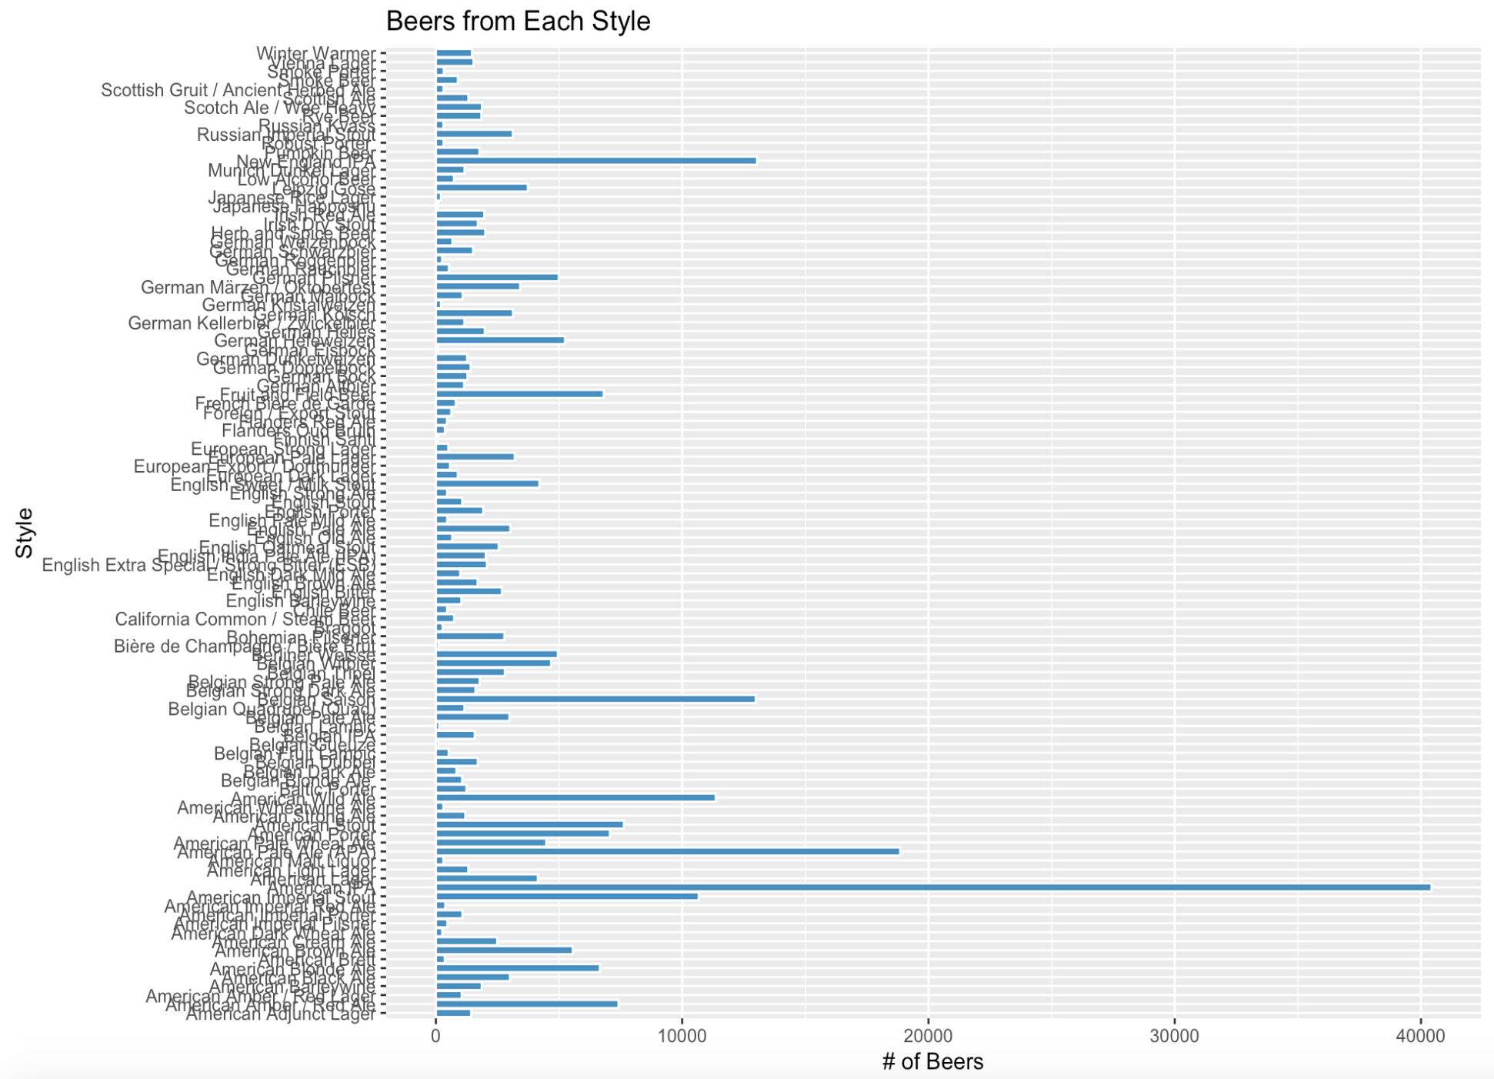

Slide 5
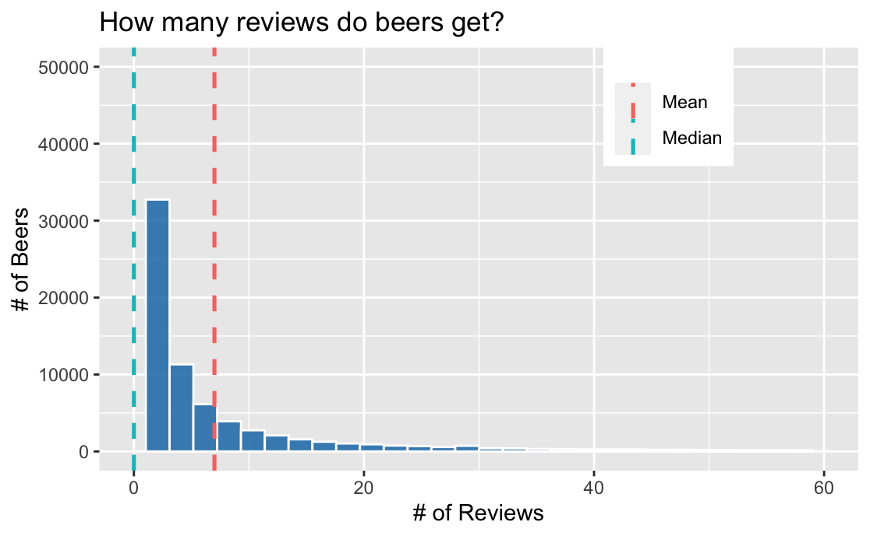
How sparse is the data?

Slide 6
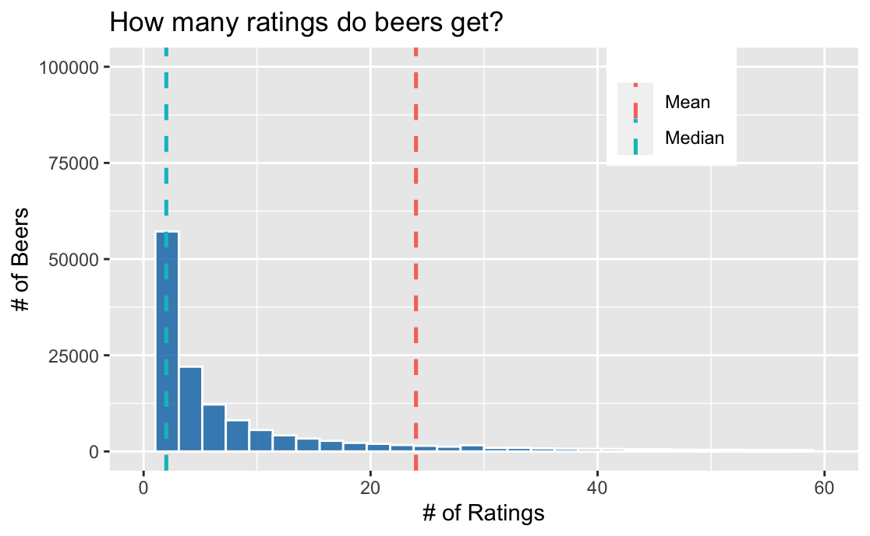
How sparse is the data?

Slide 7
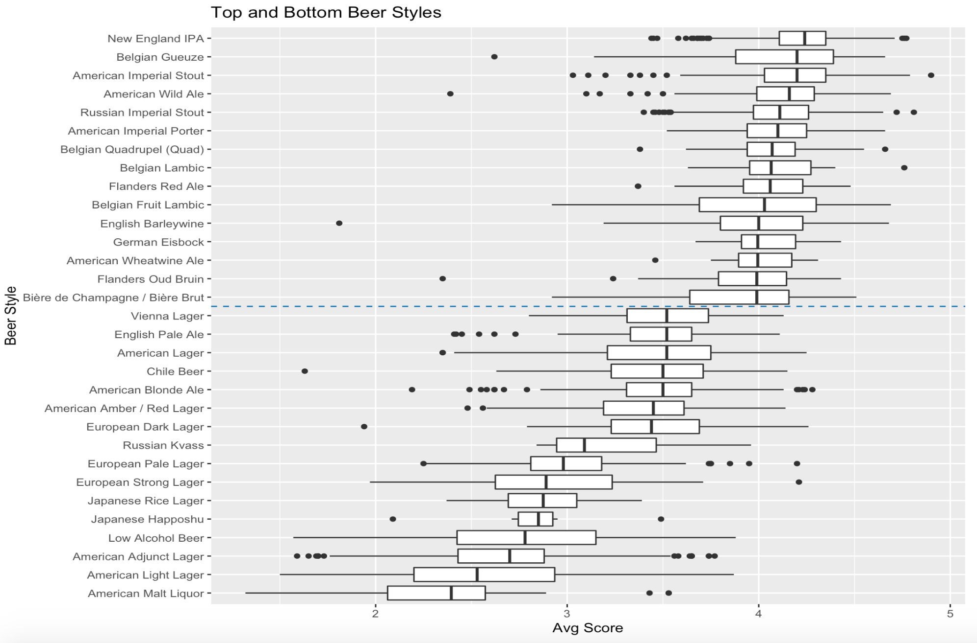

Slide 8
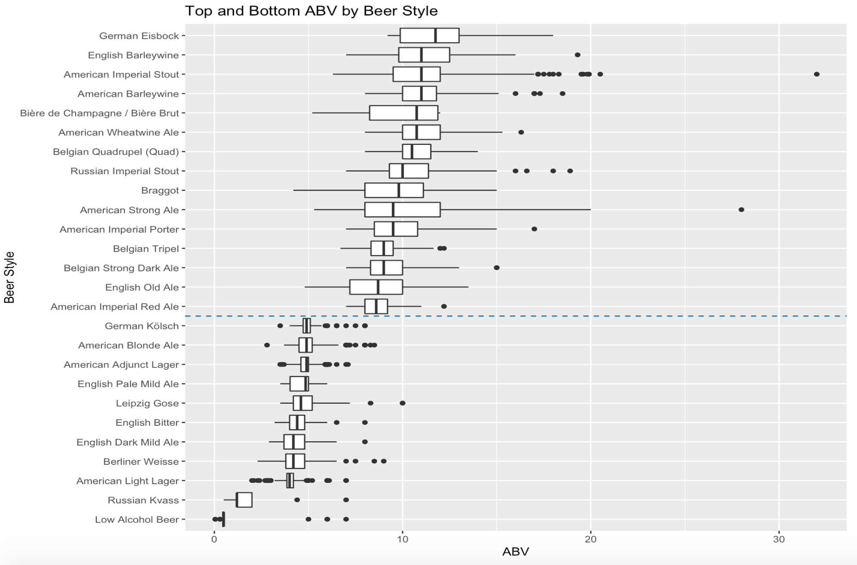

Slide 9
Improvements/Future Work
Increase Performance
Analyze the actual reviews by users to find commonalities of top rated beers

